Slide 1
ASSIGNMENT
CSS AND CSS 3

Slide 2
1 What are the benefits of using CSS?
ans: Cascading Style Sheets (CSS) is a powerful web technology that is used for controlling the presentation and layout of web pages. There are several benefits to using CSS in web development:
Separation of Concerns: CSS allows you to separate the structure (HTML) and presentation (CSS) of a web page. This separation makes it easier to maintain and update your website because changes to the design can be made without altering the underlying content.
Consistency: CSS enables you to define styles (such as fonts, colors, and spacing) in one central location and apply them consistently across multiple web pages. This helps maintain a cohesive and professional look for your website.
Flexibility: With CSS, you can control the layout and appearance of web elements with precision. You can position elements, set their dimensions, and control how they respond to different screen sizes and devices, making your site more responsive and adaptable.
Efficiency: CSS allows for the reuse of styles across different parts of a website. You can define styles once and apply them to multiple elements, reducing redundancy and making your code more efficient.
Faster Loading Times: By separating presentation from content, CSS can help reduce the file size of web pages. Smaller files load faster, improving the overall performance of your website.
Accessibility: CSS can be used to enhance the accessibility of web content. You can apply styles that make your website more readable and usable for people with disabilities, such as those using screen readers or keyboard navigation.
Maintenance and Updates: When you need to make design changes or updates to your website, you can do so more easily with CSS. This is particularly beneficial for large websites or those with frequent design revisions.
Cross-Browser Compatibility: CSS helps ensure that your website looks consistent across different web browsers. It provides a standardized way to control how web elements are displayed, reducing the need for browser-specific hacks.
SEO-Friendly: Properly structured CSS can improve the search engine optimization (SEO) of your website by making it easier for search engines to crawl and index your content.

Slide 3
11.Animation and Interactivity: CSS allows you to create animations and interactive effects without relying on JavaScript or other scripting languages. This can enhance the user experience and add visual appeal to your site.
12.Print Styling: CSS can be used to create print-friendly versions of web pages, ensuring that your content looks good when printed on paper.
13.Modularity: CSS can be organized into separate files or modules, making it easier to manage and scale styles for complex web applications and websites.
2. What are the disadvantages of CSS?
Ans:
Steeper Learning Curve: CSS can be complex, especially for beginners. Learning how to use CSS effectively, including understanding selectors, properties, and the box model, can be a steep learning curve for some individuals.
Lack of Design Control: Achieving precise design layouts can be challenging in CSS, particularly when dealing with complex designs. Some design concepts are difficult or impossible to implement with CSS alone, leading to reliance on additional technologies like JavaScript or CSS frameworks.
Maintenance Challenges: As a website grows and evolves, maintaining and organizing CSS code can become complex. Without proper organization and naming conventions, CSS files can become unwieldy and challenging to maintain.
Performance Concerns: CSS can impact page load times, especially when large or complex stylesheets are used. Excessive use of CSS properties, selectors, or animations can lead to slower website performance if not optimized properly.
Specificity and Inheritance: Understanding CSS specificity and inheritance rules can be confusing. These rules determine how conflicting styles are applied to elements, and misusing them can lead to unexpected results.
Limited Control Over Print Styles: While CSS allows for some control over print styles, creating consistent and well-formatted printed documents can be challenging, especially for complex web pages.
Responsive Design Complexity: Creating responsive web designs that adapt to different screen sizes and devices can be

Slide 4
8. complex. Media queries and other techniques are necessary to make a website responsive, which can add complexity to the CSS code.
3. What is the difference between CSS2 and CSS3?
Ans: CSS2 and CSS3 are different versions of the Cascading Style Sheets (CSS) language, which is used to define the presentation and layout of web documents. CSS3 is the newer and more advanced version, with several additional features and improvements compared to CSS2. Here are some key differences between the two:
Release Date:
CSS2: Released in 1998.
CSS3: Introduced as a set of working drafts in the early 2000s, with modules gradually being standardized over time. It doesn't have a single official release date.
Modules vs. Monolithic:
CSS2: It was a monolithic specification, meaning that all its features and properties were part of a single specification.
CSS3: It is modular, which means it is divided into separate modules, each covering a specific aspect of styling, such as typography, layout, animations, and more. Modules are developed and updated independently, allowing for greater flexibility and easier adoption of new features.
Feature Set:
CSS2: It provided a foundational set of styling capabilities, including basic layout, fonts, colors, borders, and positioning.

Slide 5
4. Name a few CSS style components
Ans: CSS (Cascading Style Sheets) provides a wide range of style components that allow you to control the presentation and layout of web elements. Here are a few essential CSS style components:
1. Color Properties:
color: Specifies the text color.
background-color: Sets the background color of an element.
border-color: Defines the color of an element's borders.
2. Typography:
font-family: Specifies the font for text.
font-size: Sets the size of the font.
font-weight: Defines the thickness of the font.
line-height: Controls the spacing between lines of text.
text-align: Aligns text within its container.
text-decoration: Adds decorations to text (e.g., underline, overline, strikethrough).
3. Layout and Box Model:
width` and `height`: Define the dimensions of an element.
margin` padding, border: Control the spacing and borders around an element.
display: Determines how an element is displayed (e.g., block, inline, flex).
position: Specifies the positioning of an element (e.g., relative, absolute).
float: Controls the alignment of an element within its container.
clear: Specifies whether an element can be adjacent to floated elements.

Slide 6
4 .Background Properties:
background-image: Sets a background image for an element.
background-repeat, background-size: Control how background images are displayed and repeated.
background-position: Positions the background image within its container.
5. Borders and Box Shadows:
border-style ,border-width`: Define the style and width of element borders.
border-radius: Creates rounded corners for elements.
box-shadow: Adds shadow effects to elements.
6. List Styles:
list-style-type: Specifies the type of list marker (e.g., disc, decimal, none).
list-style-image: Sets an image as the list marker.
list-style-position: Controls the position of the list marker (inside or outside the list item).
7. Transforms and Transitions:
transform: Applies 2D or 3D transformations to elements (e.g., rotate, scale).
transition: Adds smooth transitions to element property changes (e.g., color change, size change).
8. Animations:
@keyframes: Defines animations with multiple keyframes.
animation: Applies animations to elements and specifies animation duration, timing, and more.
9. Flexbox and Grid Layout:

Slide 7
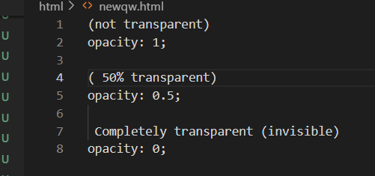
display: flex and related properties for creating flexible layouts.
display: grid and related properties for grid-based layouts.
10. Media Queries:
@media: Allows you to apply different styles based on the characteristics of the viewing device, such as screen size, resolution, or orientation.
5. What do you understand by CSS opacity?
Ans: CSS opacity refers to the level of transparency or the degree to which an element, such as text or a block, allows the background behind it to show through. It is a property that controls the visibility of an element, making it partially or fully transparent. The opacity value is defined as a number between 0 (completely transparent) and 1 (fully opaque), with decimal values in between to specify varying levels of transparency

Slide 8
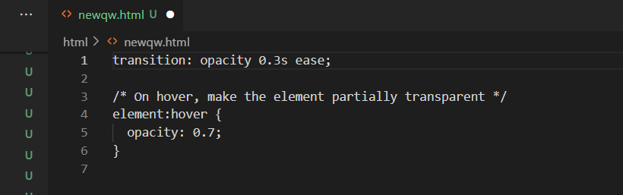
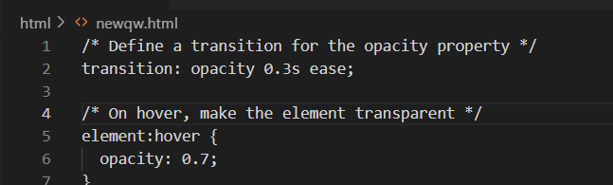

Slide 9
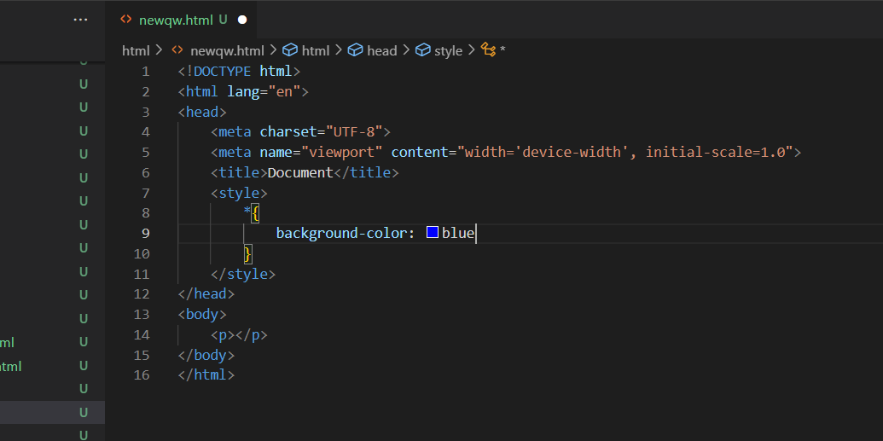
6. How can the background color of an element be changed?
Ans: bg: property to the element you want to style. You can specify the desired background color using various color notations, such as named colors, hexadecimal values, RGB values, or HSL values. Here's how you can change the background color of an element:

Slide 10
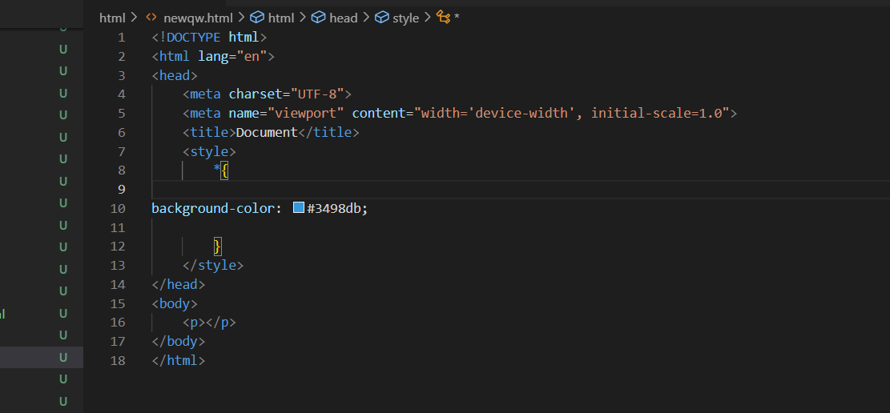

Slide 11
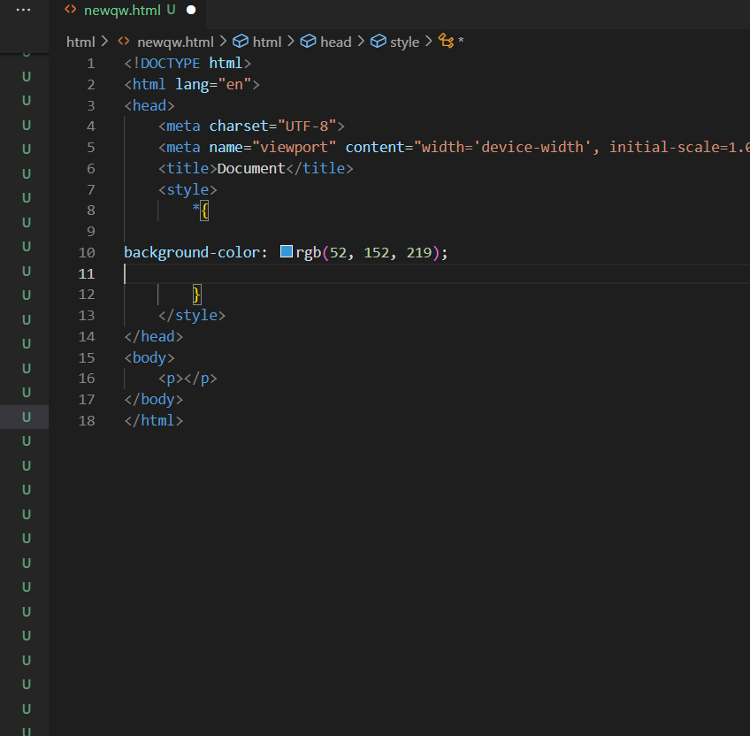

Slide 12
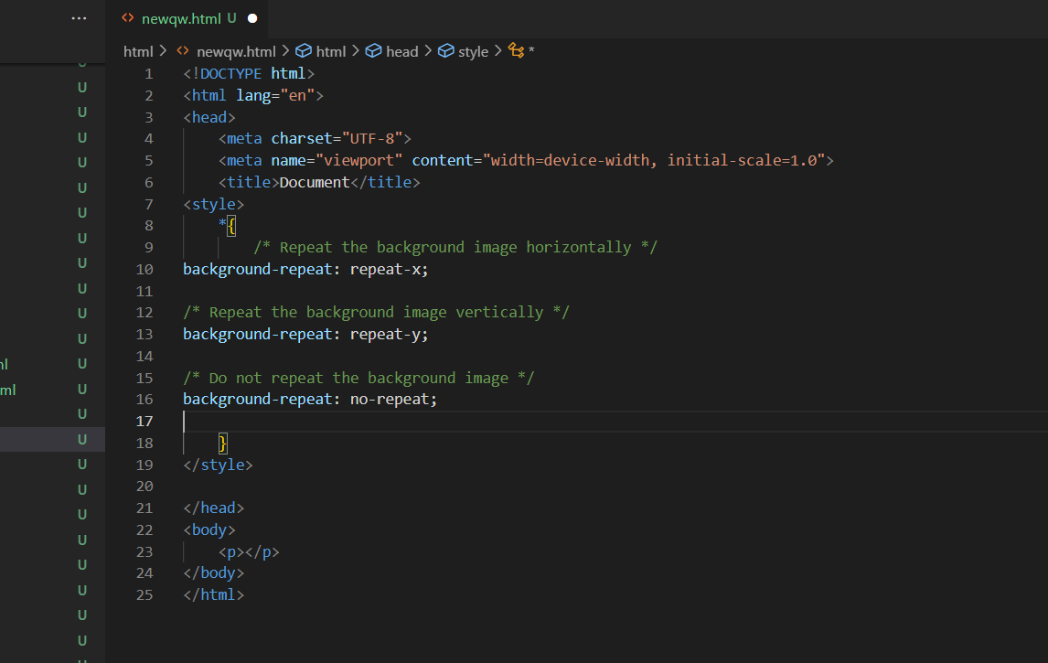
9. How can image repetition of the backup be controlled?
Ans: This property allows you to specify whether and how the background image should repeat in both the horizontal (x-axis) and vertical (y-axis) directions.

Slide 13
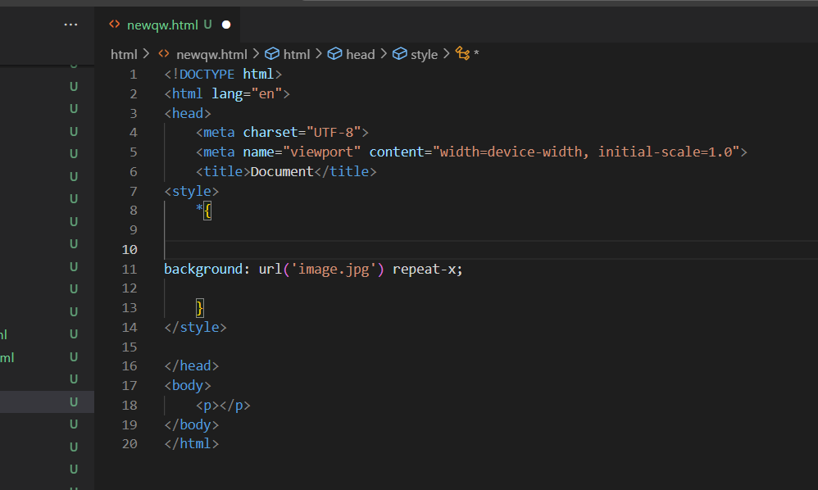

Slide 14
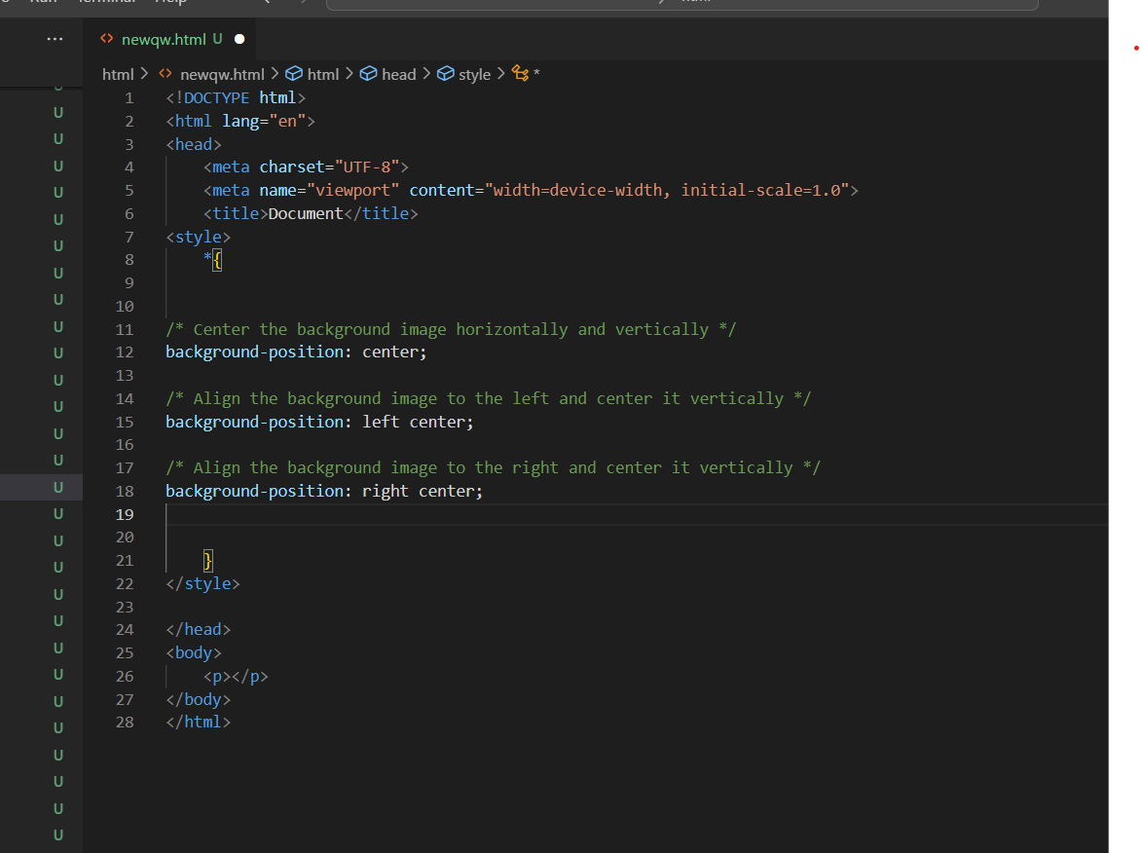
10. What is the use of the background-position property?
Ans: this in CSS is used to control the placement or positioning of a background image within its containing element. It allows you to specify where the top-left corner of the background image should be positioned relative to the top-left corner of the element. This property is particularly useful when you want to fine-tune the appearance of your background images.
One Value:

Slide 15
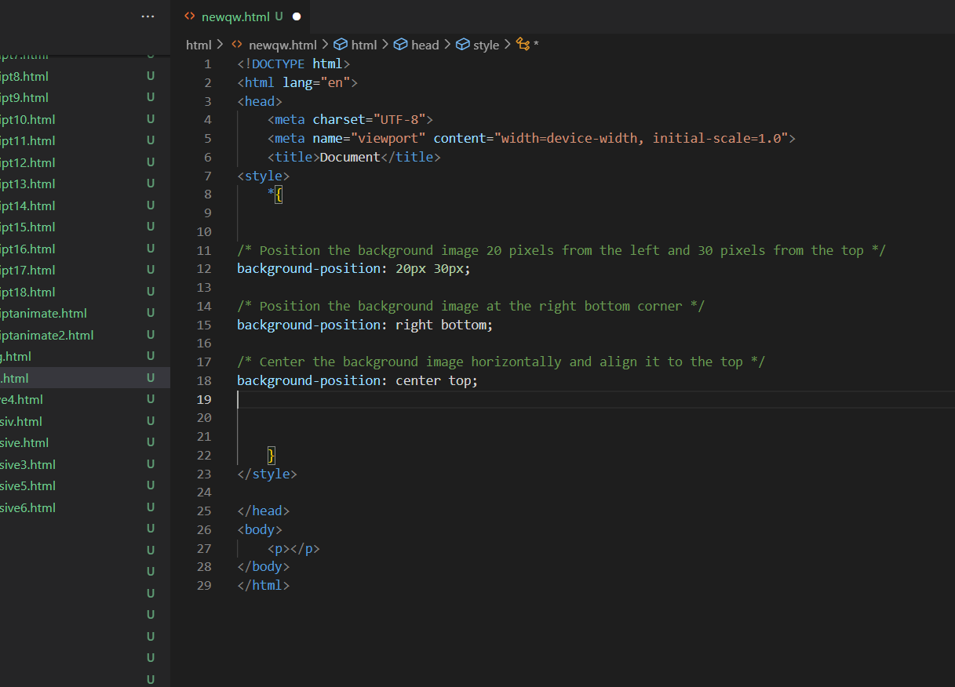
2. Two Values

Slide 16
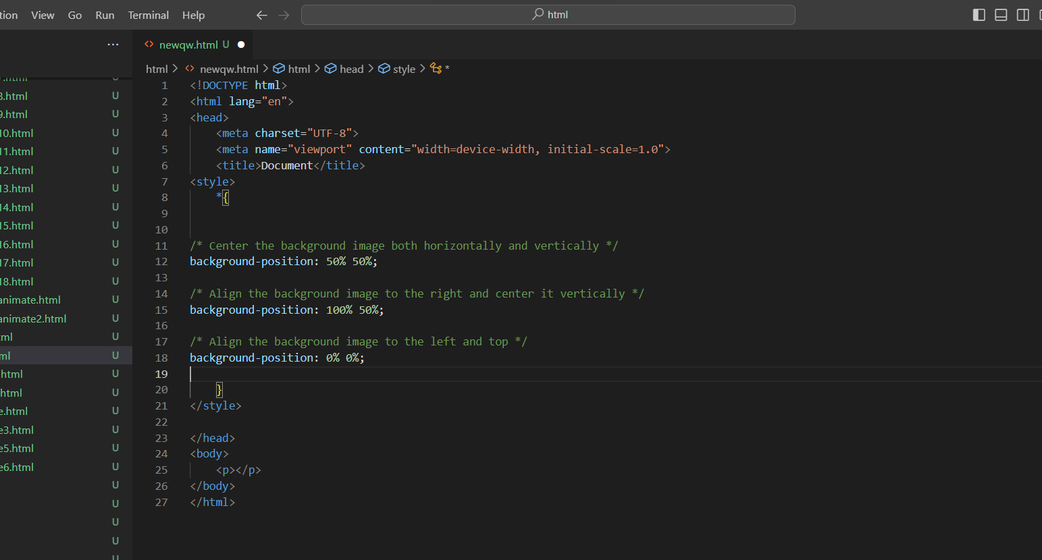
3. Percentage Values

Slide 17
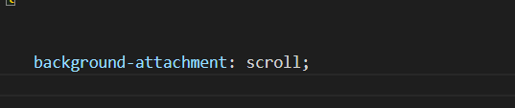

Ans: this property can accept one of the following values:
Scroll:
Fixed:
Local:
12. Why should background and color be used as separate properties?
Ans:
Background and text color should be used as separate properties in CSS for several reasons related to maintainability, readability, and flexibility in styling web pages:
Separation of Concerns: One of the fundamental principles in web development is the separation of concerns. This principle encourages keeping different aspects of web design and functionality separate for easier maintenance and scalability. By using separate properties for background and text color, you adhere to this principle, making your code more organized and maintainable.
Modularity: Using separate properties allows you to create modular and reusable CSS styles. You can define color styles (text color, link color, etc.) independently of background styles (background color, background image), making it easier to apply

Slide 18
consistent styles across your website.
Clarity and Readability: Separating background and text color properties makes your CSS code more readable and self-explanatory. It's clear at a glance which property controls the background and which controls the text color, which can be helpful for developers who work on the code in the future.
Accessibility: Properly contrasting text and background colors are essential for web accessibility. Using separate properties makes it easier to ensure that text remains readable and meets accessibility standards, as you can adjust text and background colors independently to achieve sufficient contrast.
Ease of Maintenance: When you need to make changes to either the background or text color, having them as separate properties simplifies the process. You can update one property without affecting the other, reducing the chances of inadvertently breaking your design.
Responsive Design: In responsive web design, you may need to adjust colors or backgrounds based on screen size or other factors. Separate properties allow you to apply different styles to text and background as needed for various responsive layouts.
A/B Testing: For A/B testing or split testing scenarios, where you want to compare the effectiveness of different color combinations, it's much easier to change text and background colors independently if they are separate properties.
12. How to center block elements using CSS1?
Ans: Here's one way to center block elements horizontally using CSS1:

Slide 19
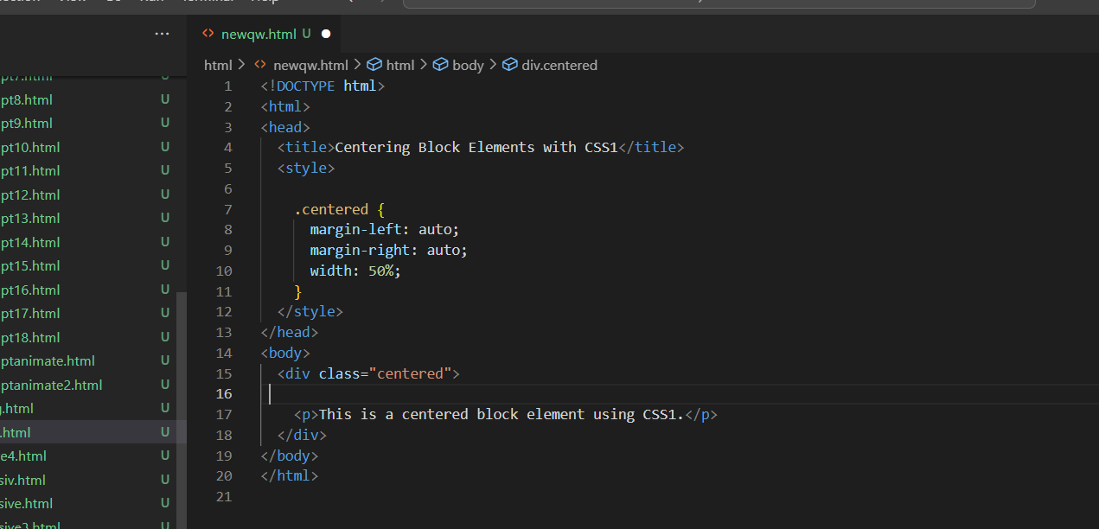

Slide 20
13. How to maintain the CSS specifications?
Ans:
Maintaining CSS specifications involves ensuring that your CSS code remains organized, up-to-date, and easy to manage as your web project evolves. Here are some best practices and strategies for maintaining CSS specifications effectively:
Consistent Coding Style:
Establish and follow a consistent coding style or naming convention for your CSS rules and selectors. This makes your code more readable and maintainable.
Modularization:
Divide your CSS code into separate files or modules based on functionality, components, or sections of your website. This promotes modularity and simplifies updates to specific parts of the site.
CSS Preprocessors:
Consider using CSS preprocessors like Sass or Less. Preprocessors allow you to use variables, mixins, and other features to write more maintainable and organized CSS.
Comments:
Use comments in your CSS code to explain complex or important sections, provide context, and document your intentions. This helps other developers (or your future self) understand the code.
Documentation:
Maintain a documentation file or document inline comments to describe the purpose and usage of CSS classes, IDs, and styles. This documentation can serve as a reference for you and your team.
Version Control:
Use a version control system (e.g., Git) to track changes to your CSS code. Commit frequently, use meaningful commit messages, and create branches for new features or bug fixes.

Slide 21
Employ CSS linters and formatters like ESLint with style guides (e.g., Airbnb style guide for CSS) to enforce code quality and consistency.
Code Reviews:
Conduct code reviews with team members to catch and fix issues early, ensure adherence to coding standards, and share knowledge.
Testing and Cross-Browser Compatibility:
Regularly test your CSS styles across different web browsers to ensure compatibility. Address any cross-browser issues promptly.
Responsive Design:
Maintain responsive design principles to ensure your website adapts gracefully to various screen sizes and devices.
Performance Optimization:
Periodically review and optimize your CSS code for performance by eliminating unused styles, minimizing unnecessary complexity, and optimizing images and assets.
Vendor Prefixes:
Keep vendor prefixes up-to-date for any CSS properties that require them. As browser support evolves, you may be able to remove some prefixes over time.
Browser Feature Detection:
Use feature detection libraries like Modernizr to apply CSS rules conditionally based on browser support rather than relying solely on user-agent detection.
Updates and Deprecations:
Stay informed about updates to CSS specifications and deprecations of older features. Keep your CSS codebase aligned with the latest best practices and standards.
Backward Compatibility:
When making changes, consider backward compatibility with older browsers or devices, if necessary. Provide fallback.
.

Slide 22
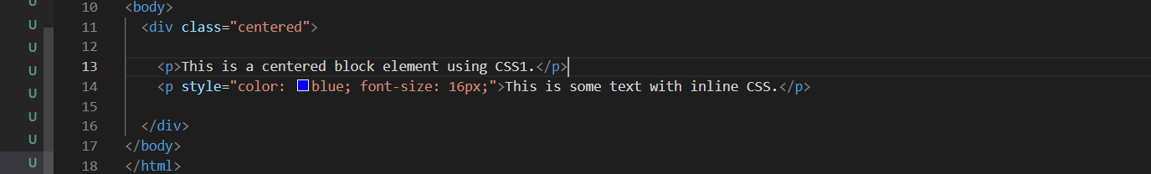
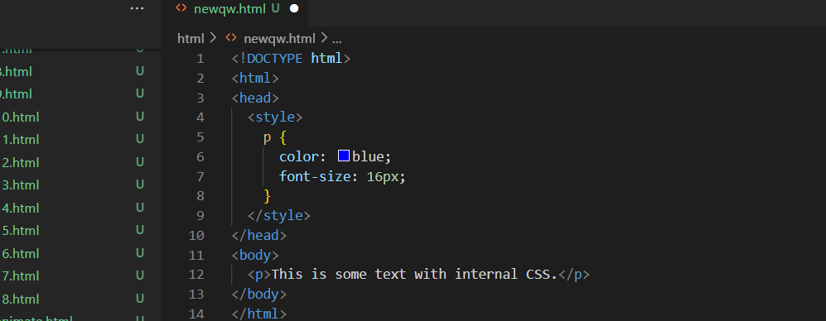
14. What are the ways to integrate CSS as a web page?
Ans:CSS (Cascading Style Sheets) can be integrated into a web page in several ways, depending on your project's requirements and needs. Here are common methods for integrating CSS into web pages:
Inline CSS:
Internal (Embedded) CSS

Slide 23
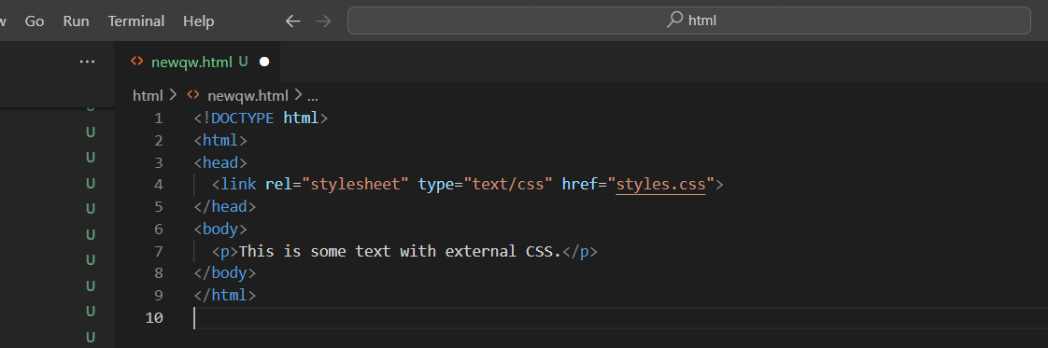
External CSS:
15. What are the external style sheets?
Ans:
External style sheets are CSS (Cascading Style Sheets) files that are created separately from an HTML document and then linked to that document. They contain a collection of CSS rules and styles that define the visual presentation and layout of HTML elements on a web page. External style sheets are an essential part of web development because they enable you to maintain consistent and organized styling across multiple web pages or an entire website. Here are some key characteristics and benefits of external style sheets:
Separation of Concerns: External style sheets promote the separation of content (HTML) and presentation (CSS). This separation is a fundamental principle in web development, as it allows developers to work on styling and structure

Slide 24

independently, making code easier to manage and maintain.
Reusability: You can reuse the same external style sheet across multiple HTML pages, ensuring a consistent look and feel throughout your website. This reusability minimizes redundancy and saves development time.
Consistency: External style sheets help maintain visual consistency, as changes made to the styles in one file automatically apply to all HTML pages linked to that file. This consistency is crucial for branding and user experience.
Ease of Maintenance: When you need to make global style changes, you can do so in a single external CSS file, avoiding the need to update styles on each HTML page individually. This simplifies maintenance and reduces the risk of errors.
Efficiency: External style sheets are cached by browsers, which means that after the initial download, subsequent visits to your website are faster since the CSS file is reused from the cache.
Organization: CSS rules in external style sheets are organized and structured in a way that makes it easy to find and manage styles for different elements, classes, or IDs.
16. What are the advantages and disadvantages of using external style sheets?

Slide 25
External style sheets, which are separate CSS files linked to HTML documents, offer several advantages and some disadvantages. Understanding these pros and cons can help you make informed decisions about whether to use external style sheets in your web development projects.
Advantages of External Style Sheets:
Separation of Concerns:
Advantage: External style sheets promote the separation of content (HTML) and presentation (CSS), which is a fundamental principle in web development. This separation makes code more organized and easier to maintain.
Reusability:
Advantage: You can reuse the same external style sheet across multiple HTML pages, ensuring a consistent look and feel throughout your website. This reusability minimizes redundancy and saves development time.
Consistency:
Advantage: External style sheets help maintain visual consistency across your website. Changes made to the styles in one file automatically apply to all HTML pages linked to that file, ensuring a uniform appearance.
Ease of Maintenance:
Advantage: When you need to make global style changes, you can do so in a single external CSS file. This simplifies maintenance and reduces the risk of errors when updating styles.
Efficiency:
Advantage: External style sheets are cached by browsers after the initial download. Subsequent visits to your website are faster because the CSS file is reused from the cache, improving overall site performance.
Organization:
Advantage: CSS rules in external style sheets are organized and structured, making it easy to find and manage styles for different elements, classes, or IDs.

Slide 26
Disadvantages of External Style Sheets:
Additional HTTP Request:
Disadvantage: Each external style sheet requires an additional HTTP request, which can slightly increase page load times. However, this impact is generally minimal and can be mitigated through optimization techniques like minification and compression.
Limited Offline Access:
Disadvantage: External style sheets are external resources, so if a user visits a page while offline or if there are network issues, the styles may not load properly.
Potential for FOUC:
Disadvantage: FOUC (Flash of Unstyled Content) can occur when the HTML content is displayed before the external CSS file is fully loaded, resulting in a brief visual inconsistency. This can be managed with appropriate design choices and loading strategies.
Reduced Portability:
Disadvantage: When sharing code or templates with others, external style sheets may require additional files or links to work correctly, making them less portable than inline or internal CSS.
Version Control:
Disadvantage: Managing version control of external CSS files, especially in a team environment, can be challenging, as updates to the CSS file may need to be coordinated with changes to the HTML files.
16. What is the meaning of the CSS selector?
ans:a selector is a pattern or identifier that specifies which HTML elements on a web page should be targeted and styled. Selectors are a fundamental part of CSS, as they determine which elements the CSS rules will apply to. Selectors are used to "select" one or more HTML elements to which you want to apply a particular set of styles

Slide 27
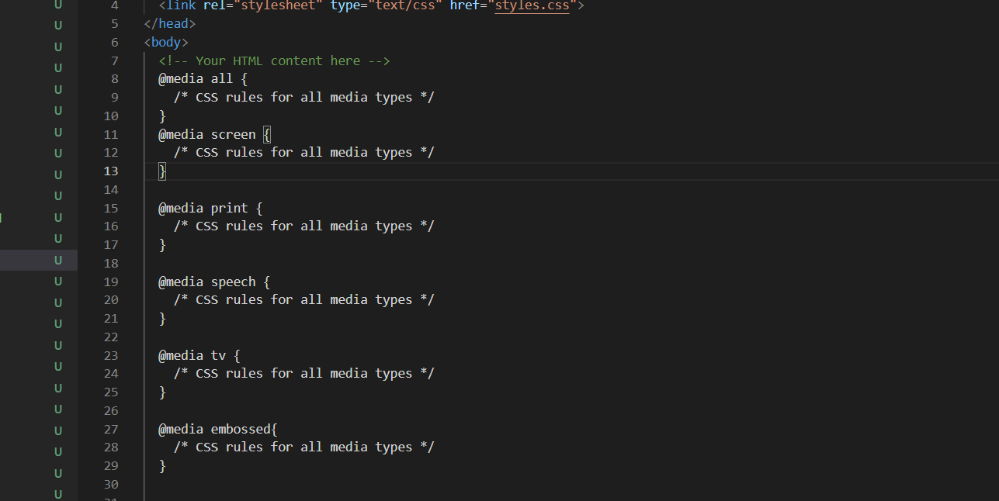
18. What are the media types allowed by CSS?
Ans:
Css supports several media types that allow you to apply styles based on different output devices or conditions. Media types specify the intended output media for which the CSS rules should be applied. Here are some of the commonly used media types in CSS

Slide 28
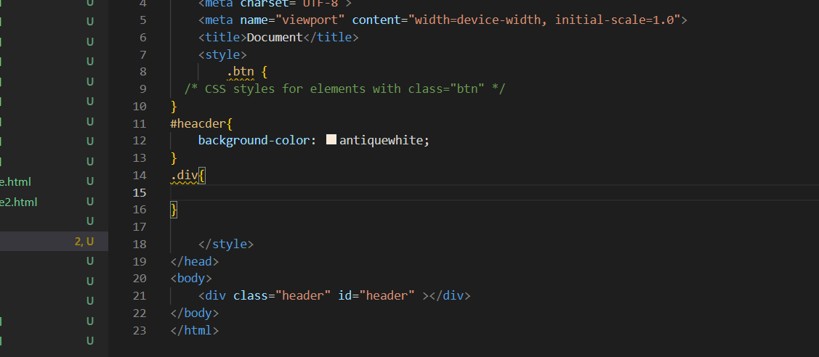
19. What is the rule set?
Ans: In CSS a rule set, also known simply as a "rule," is a fundamental structure that defines how an HTML element or a group of elements should be styled. A rule set consists of two main parts: a selector and a declaration block.
20. Create a layout: ans

Slide 29
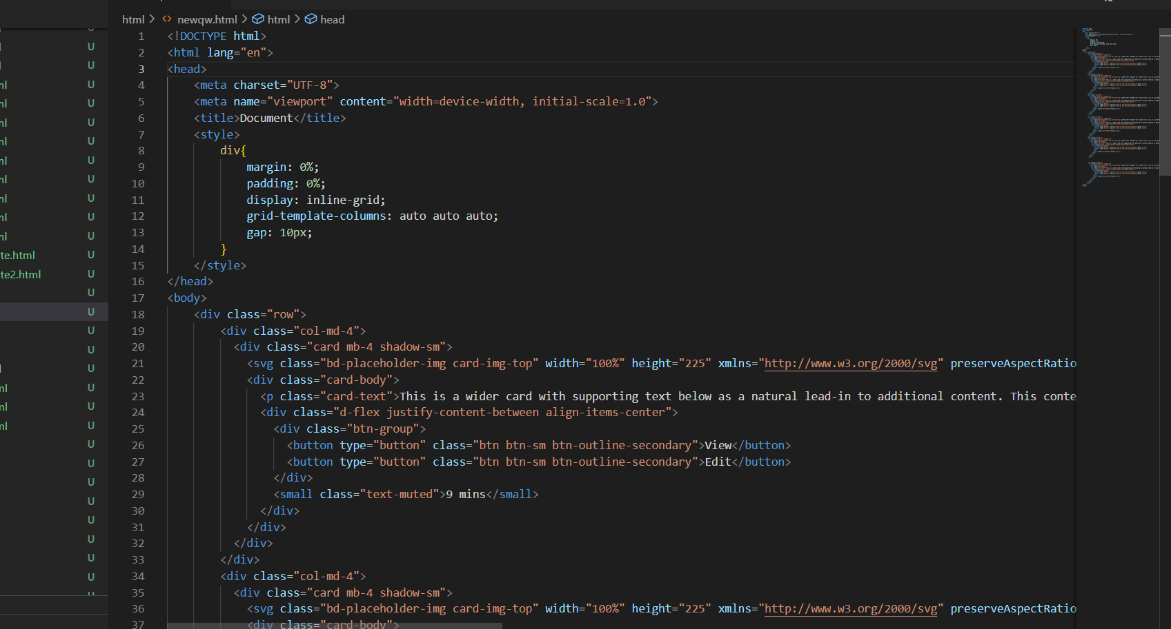

Slide 30
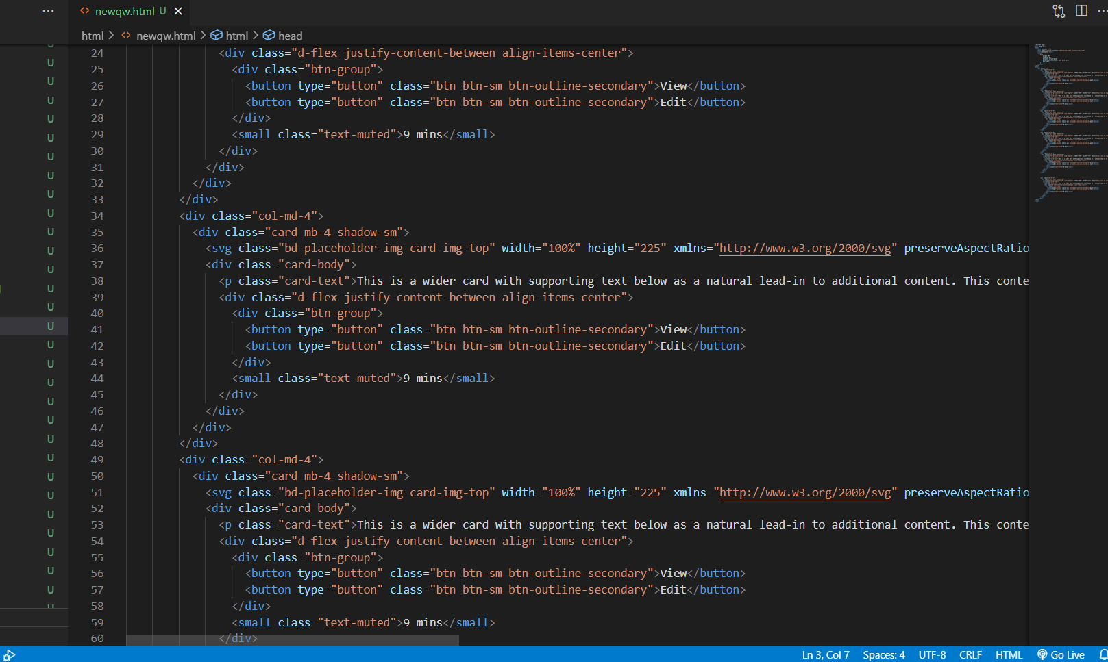

Slide 31
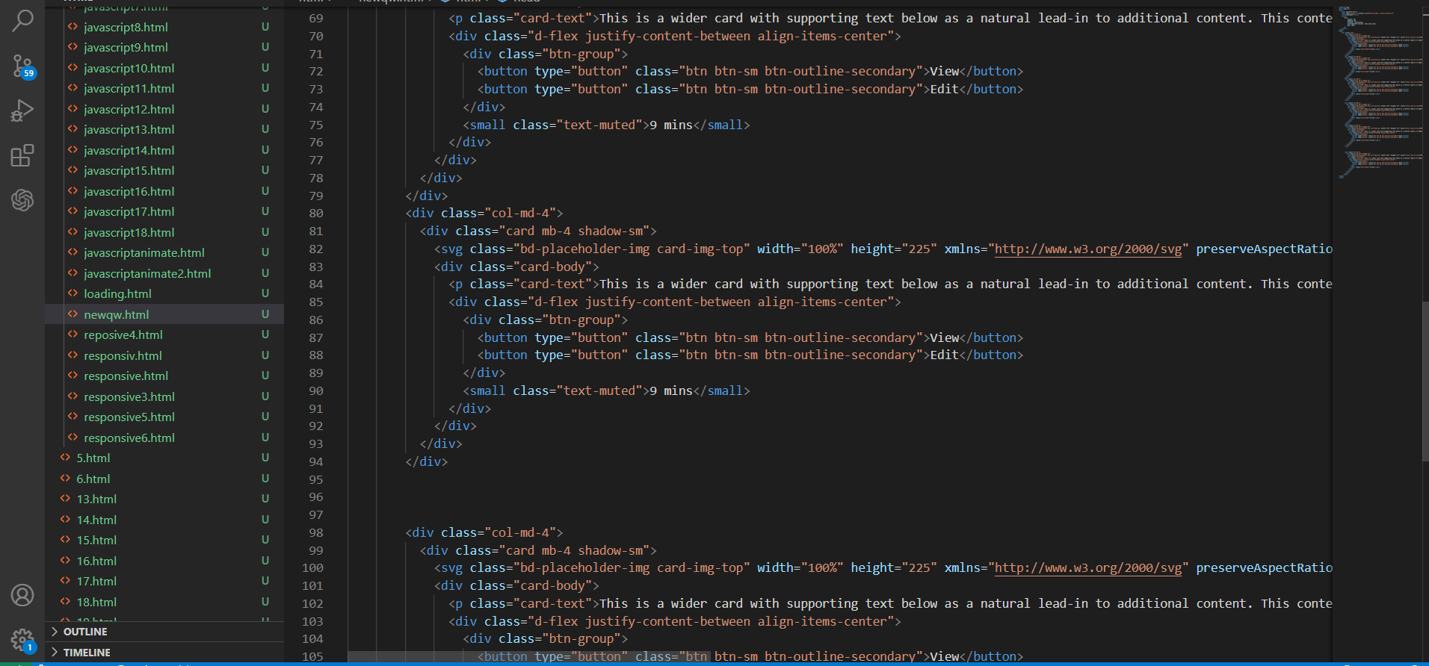

Slide 32
